Slide 1




A STUDY OF RARE BEAUTY VERSUS BOBBI BROWN

Slide 2



Introduction

Slide 3


A COMPARISON OF INTERNATIONAL BEAUTY BRANDS
“BOBBI BROWN” AND “RARE BEAUTY”

Slide 4


TREND FOR INTERNATIONAL COSMETICS IN INDIAN MARKET
1. HUDA BEAUTY:
HUDA BEAUTY is a cosmetics line that was launched in 2013 by Huda Kattan.
In 2017, Huda Kattan was chosen as one of the “Top Three beauty Influencers” by Forbes.
Huda Beauty has entered the Indian market with an exclusive partnership with India’s leading beauty platform Nykaa.

Slide 5
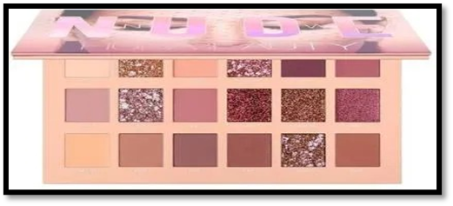

THE NUDE PALETTE:
Most popular.
Stocked with 18 highly pigmented shades.

Slide 6
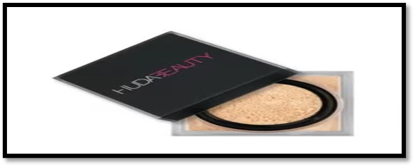
EASY BAKE POWDER:
Available in shades that suit Indian skin tones.
Great for sealing your foundation.

Slide 7
2. M.A.C. :
Originally a Canadian company.
Market leader in global markets.
Catering to specific needs.
Avoiding mass strategy.

Slide 8
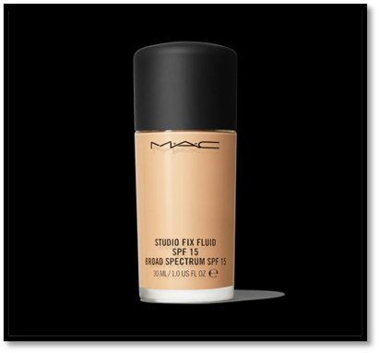
STUDIO FIX FLUID SPF 15:
Multitasking liquid foundation.
Medium-to-full coverage.
Lasts upto 24 hours.
Available in 63 shades.

Slide 9
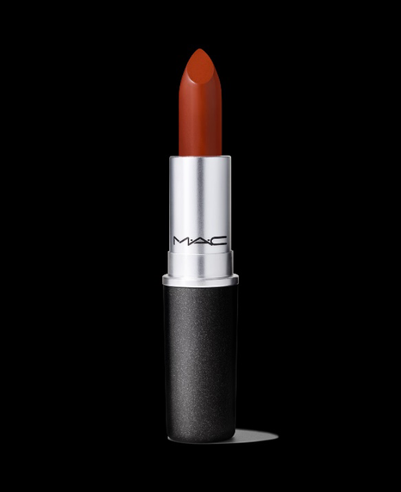
M.A.C LIPSTICK:
M·A·C matte Lipstick- The iconic product.
Best-selling product from M·A·C.
Available in many colours.
Most popular lipstick colours.

Slide 10
3. SMASHBOX:
Exceptionally high quality.
Skin-friendly.
Photo finish glow.
Incredibly lightweight.
Excellent results for acne-prone skin.
Products are PETA certified and cruelty-free.

Slide 11
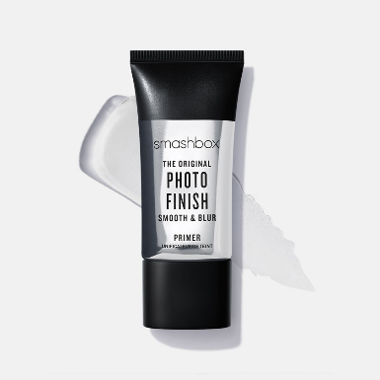
PRIMER:
Smoothens your complexion.
Contains vitamins B, C, and E.
Nourish, protect, and refresh your skin.

Slide 12
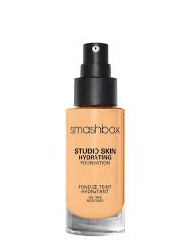
SMASHBOX STUDIO SKIN HYDRATING FOUNDATION:
Blends seamlessly.
Covers all skin imperfections.
Lasts up to 15 hours.
Enriched with polymers.

Slide 13
4. TOO FACED MAKEUP MAKE UP PRODUCTS:
Covers spots and signs of aging.
Great packaging.
Wide range of products.

Slide 14
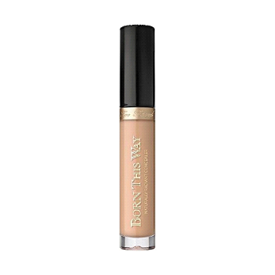
BORN THIS WAY NATURALLY RADIANT CONCEALER:
Hides imperfections instantly.
Comfortable to wear.
Skin look flawless.

Slide 15
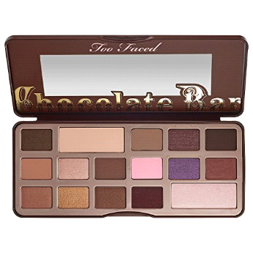
THE CHOCOLATE BAR EYE PALETTE:
Must have if you are a makeup junkie and chocoholic.
Consists of 16 matte shadows.
Scented with actual chocolate.
Featured shades.
Best chocolate themed eyeshadow palettes.

Slide 16
WHY INTERNATIONAL COSMETIC BRAND ENTER IN INDIA?
Country's vast young population.
Rising disposable income.
Economic difficulties in China, which is Asia's largest market for cosmetics.
International brands are interested in the raging market in India.
Establish stronghold beforehand in order to reap the benefits during the very early stages.

Slide 17
SIGNIFICANT INTERNATIONAL COSMETIC BRANDS AVAILABLE IN STORES (OFFLINE) IN AHMEDABAD

Slide 18
MAYBELLINE
HISTORY
MAYBELLINE PRODUCTS
Great Lash Washable Mascara Fit Me Matte + Poreless Liquid Foundation Instant Age Rewind Concealer Lash Sensational Mascara Cheek Heat Gel-Cream Blush

Slide 19
MAC COSMETICS
HISTORY
PRODUCTS
Studio Fix Fluid Foundation
Ruby Woo Lipstick
Prep + Prime Fix+ Setting Spray
Pro Longwear Concealer
Studio Fix Powder Plus Foundation
Lip Pencil

Slide 20
ORIFLAME
HISTORY
PRODUCT PHILOSOPHY
For them, beauty is a way of life to be healthy, enjoy beautiful skin, express oneself and have fun together. At the same time, their products must be safe, reliable and deliver the results they promise. This philosophy is what guides them in creating products you can trust and fall in love with

Slide 21
BODY SHOP
HISTORY
The Body Shop International Limited, trading as The Body Shop, is a British cosmetics, skin care and perfume company.

Slide 22
L’Oréal
HISTORY
FIRST PRODUCT
When The Body Shop first opened its doors in 1976, it was a little green-painted shop in the streets of Brighton, England.
Its approach to beauty was radically different to the big players in the beauty industry.
The Body Shop carries a wide range of products for the body, face, hair and home.
The Body Shop claims its products are “inspired by nature” and feature ingredients such as marula oil and sesame seed oil sourced through the Community Trade program.

Slide 23
Products include:
Bodybutters
Body products such as body scrub, body butter and bath lilies
Cosmetics
Full skin care ranges
Men’s skin care
Hair care
Fragrances (Women’s and Men’s)
Bath products including shower gels and solid soaps
High-end skincare range such as Oils of Life
Face masks including sheet masks

Slide 24
BOBBI BROWN

Slide 25


HISTORY OF BOBBI BROWN:
● founded by makeup artist Bobbi Brown in 1991.
●gained popularity for its high-quality products.
● Acquisition by Estée Lauder: provided greater resources and opportunities for expansion.
● Global Expansion: establishing a strong presence in various countries and becoming a beloved brand worldwide.

Slide 26
MAKEUP AND SKINCARE PRODUCTS OF BOBBI BROWN:
● Foundation: Such as Long-Wear Weightless Foundation, Foundation Stick and Intensive Skin Serum Foundation.
● Concealer: the Instant Full Cover Concealer and Creamy Concealer Kit.
● Lipstick: including the Luxe Lip Color, Crushed Lip Color and Nourishing Lip Color.
● Skincare: moisturizers, serums and cleansers, tailored to various skin types.

Slide 27
PRICING OF BOBBI BROWN COSMETIC PRODUCTS :
Bobbi Brown is considered a high-end cosmetics brand . Here are some general price ranges of their popular products:
● Foundation: around 3000/- to 5000/-, depending on size.
● Concealer: between 2400/- to 4000/-,
● Lipstick: typically priced around 2000/- to 3500/-.
● Skincare: ranging from around 1600/- to over 8200/-.

Slide 28
VARIOUS MARKETING STRATEGIES:
● Celebrity Endorsements: collaborated with celebrities and influencers.
● Social Media Marketing: shared makeup tutorials with customers on social media.
● In store events : to provide personalized experiences for customers and showcase their products.
DISTRIBUTION STRATEGIES:
● Online Presence: purchase products directly online by customers from their official website.
● International Expansion: expanded to reach customers in different countries and partnering with local retailers.
● Studios and Counters: set up in various cities to try out products for customers.

Slide 29
Rare Beauty : A Celebration of You

Slide 30


INTRODUCING A RARE BEAUTY :
● Founded in February 2019 by singer and actress Selena Gomez.
● Mission: Break down unrealistic beauty standards and celebrate individuality.
● Products: Vegan and cruelty-free makeup with a focus on inclusivity.
● Launched in September 2020 with 48 shades of foundation and other products.
● Expanded to new markets and gained significant popularity, especially for its blush.
DEVELOPMENT OF RARE BEAUTY :
● Established the Rare Impact Fund to raise $100 million over 10 years.
● Committed to mental health awareness and education.
● Donates a percentage of sales and partners with others to support the fund.
● Awarded $1.2 million in grants in its first year.

Slide 31
PRODUCT RANGE :
● Wide range of makeup: Rare Beauty offers over 200 products for face, lips, and eyes, including foundation, concealer, blush, and tools, catering to all steps of a makeup routine.
● Focus on lightweight, buildable formulas: Their products aim to be lightweight and breathable while allowing for buildable coverage, appealing to those who prefer a natural look.
● Fan-favorite blush: The Stay Vulnerable Melting Cream Blush is a top-seller, praised for its easy blendability and shade range that caters to diverse skin tones.
PRICING STRATEGY:
● Competitively priced: Rare Beauty sits between drugstore and luxury brands in terms of price, aligning with other
celebrity competitors like Ariana Grande and Rihanna.
● Leverages Selena Gomez's reach: Selena Gomez actively promotes Rare Beauty on her massive social media
platforms, creating buzz and showcasing product use.
● Drives sales through celebrity influence: By using and loving the products publicly, Selena Gomez entices fans to
purchase the same items she uses.
● Product Price ranges between $19-$24.

Slide 32
MARKETING STRATEGY:
● Selena leverages her immense social media following: She uses her own Instagram account (300 million followers) and Rare Beauty's (3 million followers) to announce brand news, post behind-the-scenes content, and showcase products.
● She actively uses and promotes Rare Beauty products: From "Get Ready with Me" videos to featuring the brand in interviews and collaborations, Selena demonstrates her genuine love for the products, driving consumer interest and desire.
● Consumers can easily buy the products: By linking to products in captions and using Instagram's shopping feature, Selena makes it seamless for fans to purchase the exact items she uses.
DISTRIBUTION STRATEGY :
● Global expansion: Rare Beauty has gone from its North American launch to select countries in Europe, Middle East, and Asia Pacific, with plans for further expansion.
● Strategic partnership with Sephora: The brand leverages Sephora's extensive network of stores and online presence, allowing customers to test products before buying.
● Focus on accessibility: By being available both online and in physical stores, Rare Beauty caters to diverse consumer preferences.

Slide 33
Summary of Research Papers

Slide 34


SUMMARY OF RESEARCH PAPER:RARE BEAUTY
● Meaning of Beauty in Rare Beauty Ad: The ad promotes three key messages:Everyone possesses unique beauty,Confidence enhances beauty and happiness,Beauty standards shouldn't be dictated by societal norms.
● Advertising's Influence on Beauty Perception: Online media and advertising significantly impact how individuals perceive beauty and self-image,They can promote unrealistic beauty standards and ideals,It's crucial to critically analyze media messages and challenge these narrow definitions.
● Research Method: The study employed qualitative analysis, using existing research and literature to understand the impact of advertising on beauty perception.

Slide 35
SUMMARY OF RESEARCH PAPER: BOBBI BROWN
● Building a strong brand identity:Founder characteristics, like Bobbi Brown's expertise, can shape brand identity,A clear
identity helps connect with consumers and fosters loyalty.
● Accessibility and building trust:Wide availability (physical and online stores) allows for easy access and brand
experience,Educational resources (online tutorials, consultations) build trust and empower consumers.
● Leveraging founder's legacy and attracting new audiences:Loyal Bobbi Brown fans follow her new ventures, creating a
strong initial customer base,New brand concepts attract curious consumers seeking fresh beauty solutions.

Slide 36
INTERNATIONAL COSMETICS BRAND AVAILABLE IN INDIA :
● Luxury Market Growth: The Indian luxury cosmetics market is experiencing rapid growth, driven by women consumers seeking social and personal value from these brands.
● Shifting Preferences: While traditional Indian beauty solutions like herbal and Ayurvedic products still exist, many consumers are increasingly drawn to international brands.
● Growing Popularity of International Names: Brands like Huda Beauty, L'Oreal, and Lakme are gaining traction, particularly in major cities like Mumbai and Hyderabad. This is fueled by: Diverse product offerings:
These brands cater to various needs and preferences,Effective marketing: Strong marketing strategies further reinforce brand image and desirability,Economic factors: India's economic liberalization and growing disposable income contribute to this trend.

Slide 37
Research
Methodology

Slide 38
Objectives
One Way
ANOVA
Primary
Objectives
Objectives
Chi square
Test
Secondary
Objectives

Slide 39











Sampling Method
Judgement Sampling
Sampling Size
We have Collected Sample from 200 Female Respondents.

Slide 40
Limitations of the study
Time Consuming
Some may have filled
wrong data
Some have
Declined to
fill the form
May lead to wrong conclusions

Slide 41
Findings and
Analysis

Slide 42
Finding and analysis of Secondary objectives

Slide 43
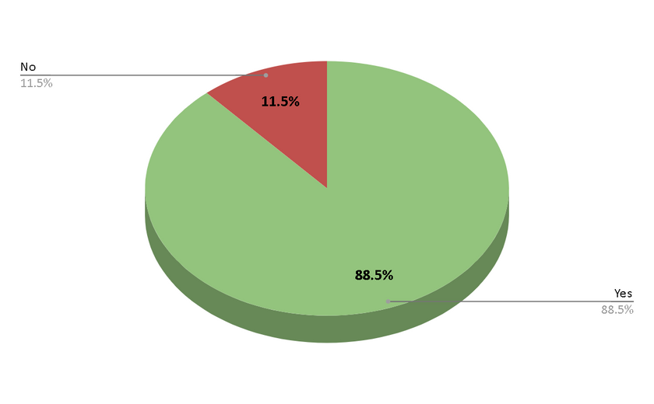
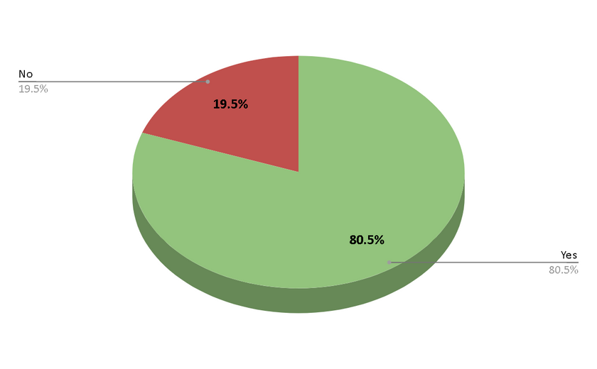

Q. 1 Are you familiar with beauty brands Rare Beauty and Bobbi Brown?
Q. 2 Do you use cosmetics from Bobbi Brown and/or Rare Beauty?
YES > NO
Yes : 88.8% (177)
No : 11.5% (23)
Successfully established
Strong presence
YES > NO
Yes: 80.50% (161)
No: 19.5% (39)

Slide 44
Users of Rare Beauty and Bobbi Brown.

Slide 45
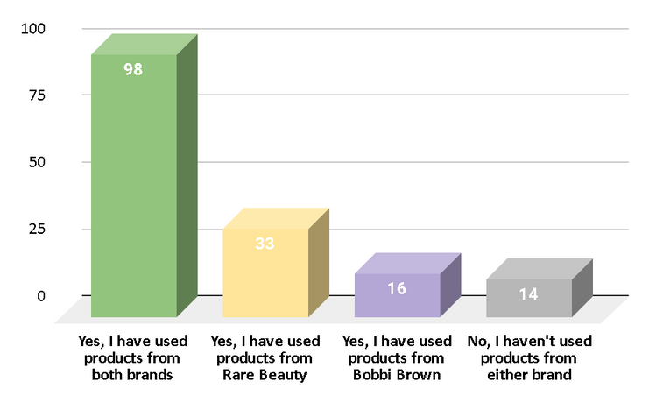
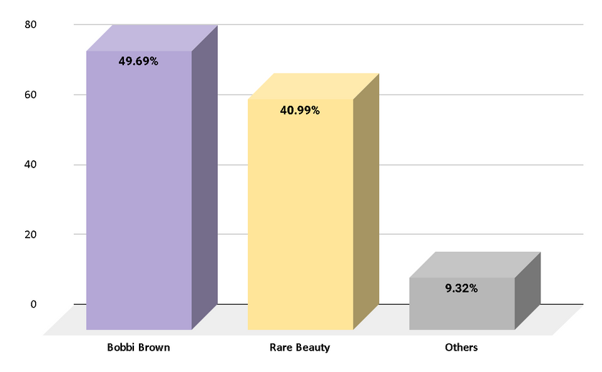
Q.1 Have you used beauty products from Rare Beauty and Bobbi Brown?
Q. 2 Which brand do you prefer for makeup products?
Respondents used products from both brands : 98
Respondents used products from Rare Beauty : 33
Respondents used products from Bobbi Brown : 16
Respondents haven’t used products from either brand : 14
Bobbi Brown(49.69%) > Rare Beauty(40.99%)
Slight preference among respondents
Enjoy significant favorability
Individuals opinion and choice

Slide 46
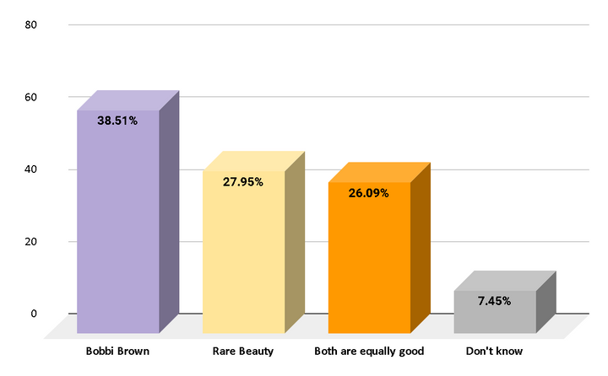
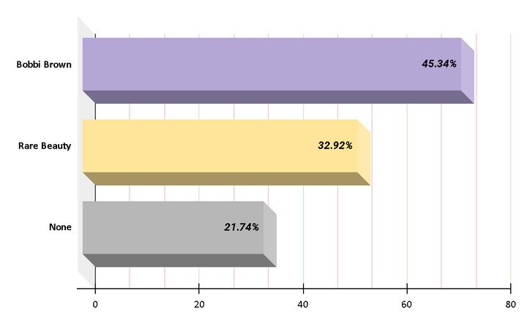
Q.3 Which brand products do you think have a longer-lasting effect and better performance?
Q.4 Which brand products are more affordable?
Bobbi Brown (45.34%) > Rare Beauty(32.92%)
Affordability and Budget-friendly
Pricing strategy
Bobbi Brown(38.51%)
Effectiveness

Slide 47
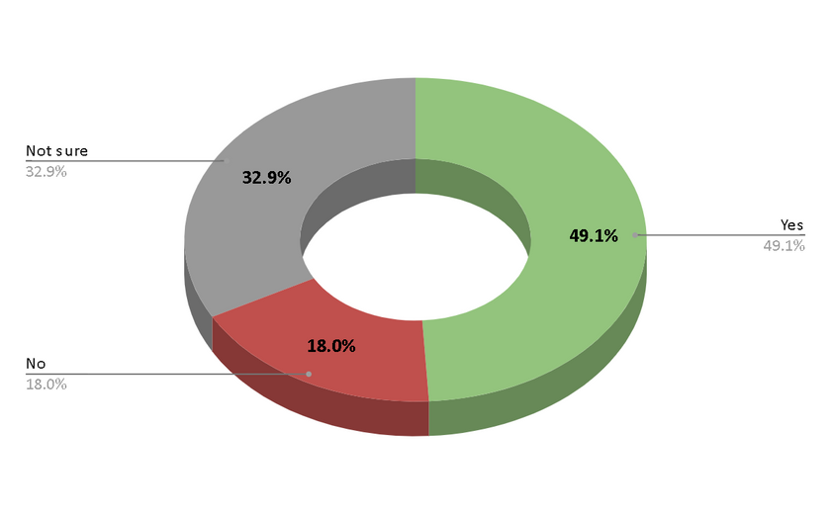
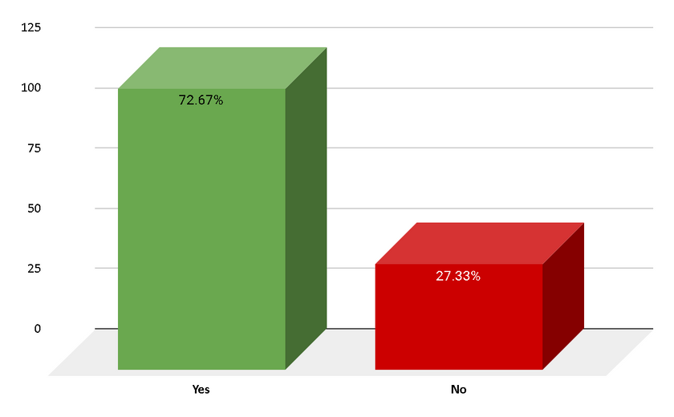
Q.5 Is Bobbi Brown foundation better than Rare Beauty?
Q. 6 Is Rare Beauty lipstick long lasting than Bobbi Brown?
Yes(49.1%) > No(32.9%)
Additionally, 32.9% of respondents are unsure
Yes (72.67%) > No(27.33%)

Slide 48
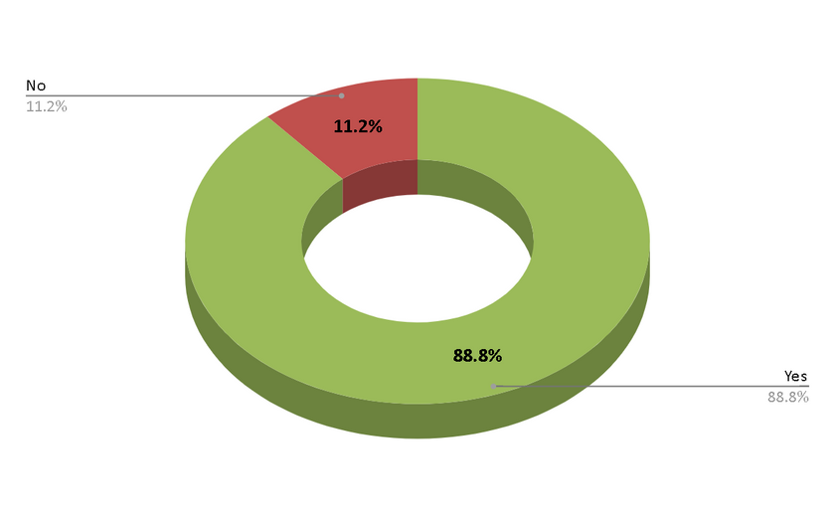
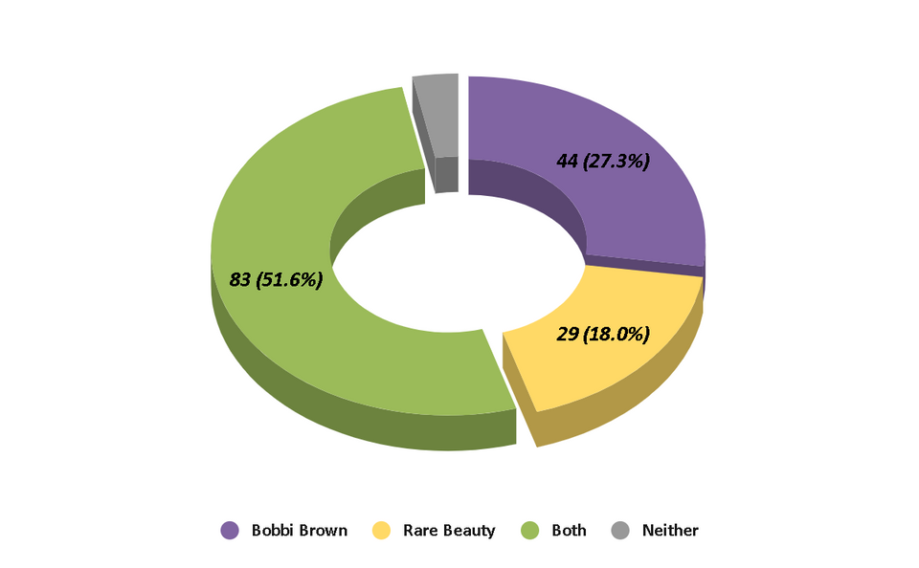
Q. 7 Do these two brands have Sun Protection Factor in their products?
Q. 8 Which brand products are waterproof, sweatproof and transfer-resistant?
Yes(88.8%) > No(11.2%)
Offering SPF products - consumers needs and preferences
Bobbi Brown : 44 (27.3%)
Rare Beauty : 29(18.0%)
Both : 83 (51.6%)
Expectation among consumers for makeup products
Long lasting and durable under different conditions

Slide 49
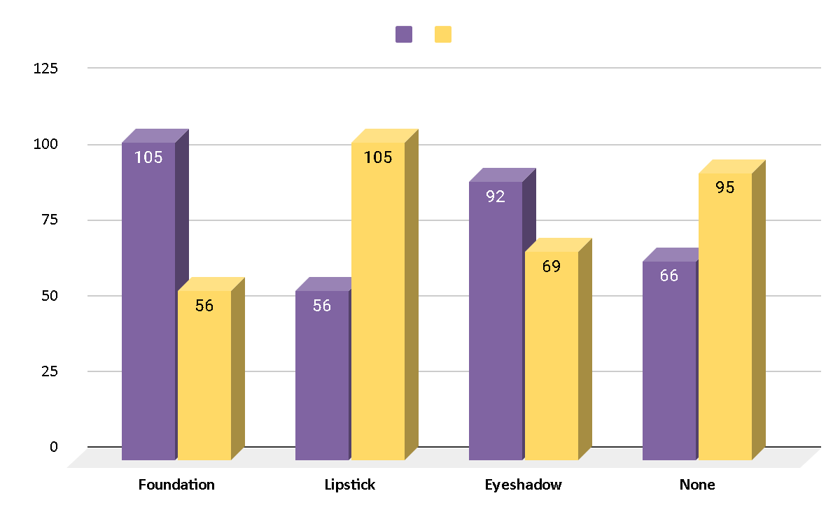
Q. 9 What is the most selling product from these two brands?
Foundation : Bobbi Brown (105)
Lipstick : Rare Beauty (105)
Eyeshadow : Bobbi Brown (69)

Slide 50
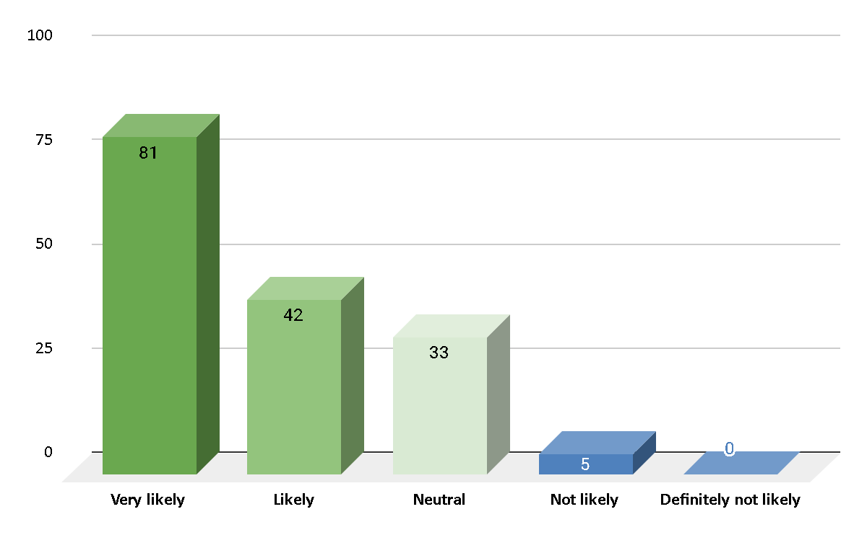
Q. 10 If price were not a consideration, how likely or unlikely are you to purchase products from these brands?
Lower price – higher demand
Cost of makeup

Slide 51
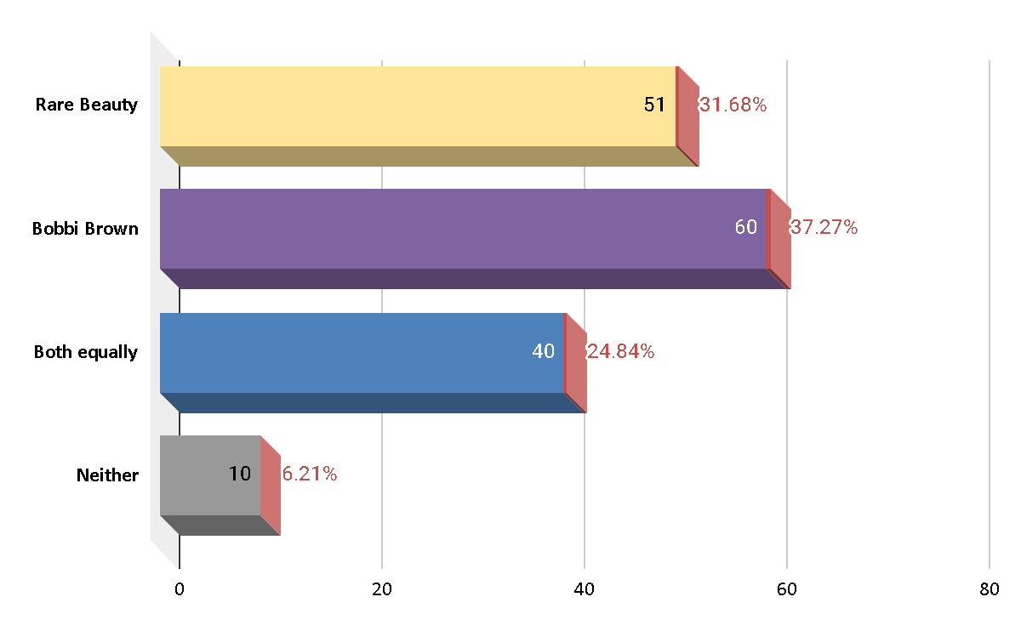
Q. 11 Which brand products are you more likely to use in the future?
Valuable insights in to future

Slide 52
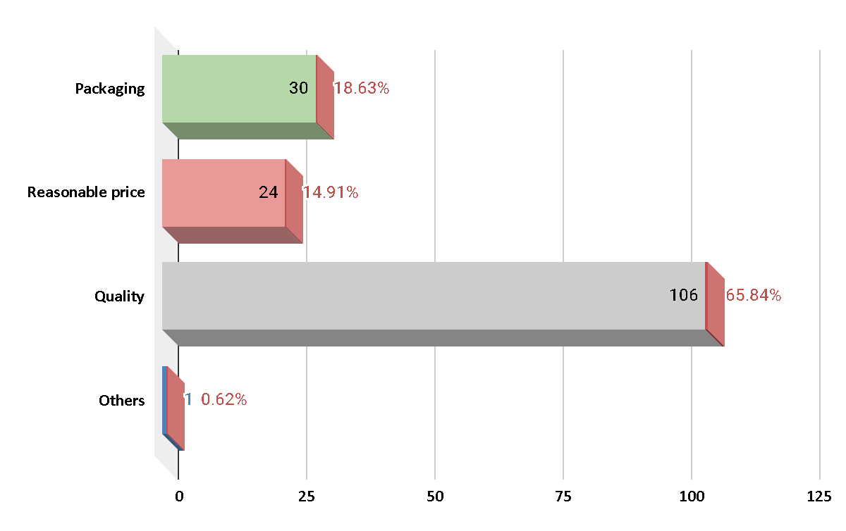
Q. 12 What would be the main factor influencing your choice of future product usage?
Quality(106) > Packeging(30) > Reasonable Price(40) > other(1)
Quality : product effectiveness and performance
Packaging : presentation , visual
Reasonable price : affordability

Slide 53
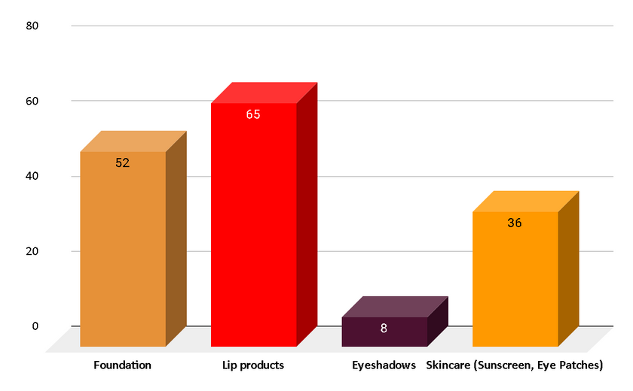
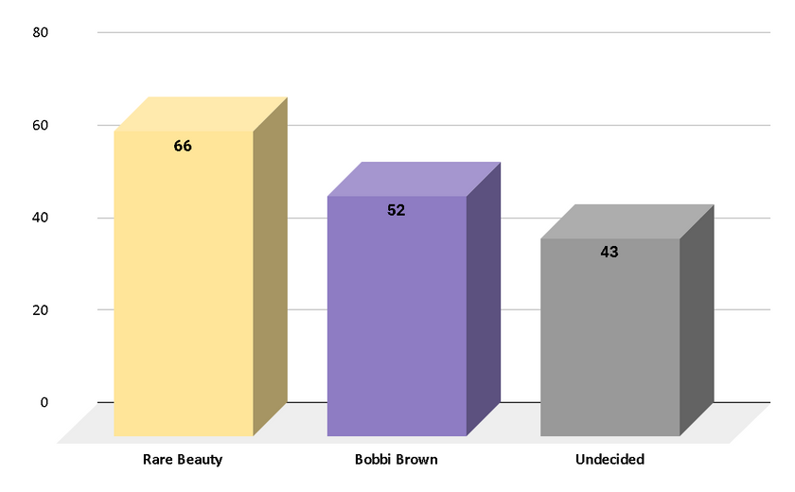
Q. 13 Which specific type of product are you more likely to consider for future usage from your preferred brand?
Q. 14 If you were to purchase a product within the next month, which brand would you lean towards?
Lip Products : 65
Foundation : 52
Skincare : 36
Eyeshadows : 8
Diverse preferences
Rare Beauty : 66
Bobbi Brown : 52
Undecided : 43 (uncertainity in brand preferences)
Purchasing intentions

Slide 54
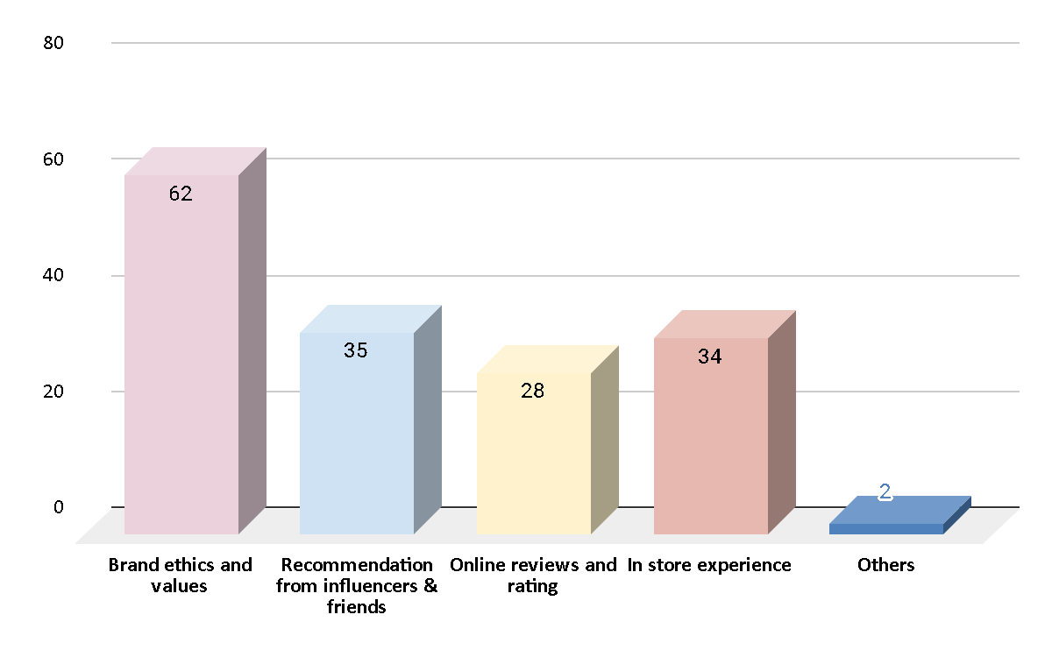
Q. 15 If you choose a preferred brand for future usage, what influenced your decision the most?
Brands that stands for social responsibility, sustainabilty
Personal recommendations
Positive store experience
Positive reviews and high ratings

Slide 55
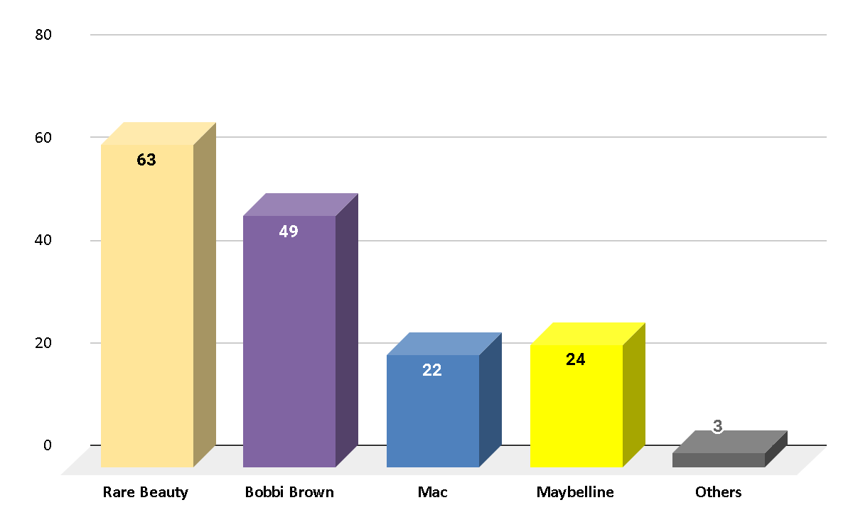
Q. 16 What beauty products are you willing to buy at high prices?
Premium beauty products
Luxury cosmetics

Slide 56
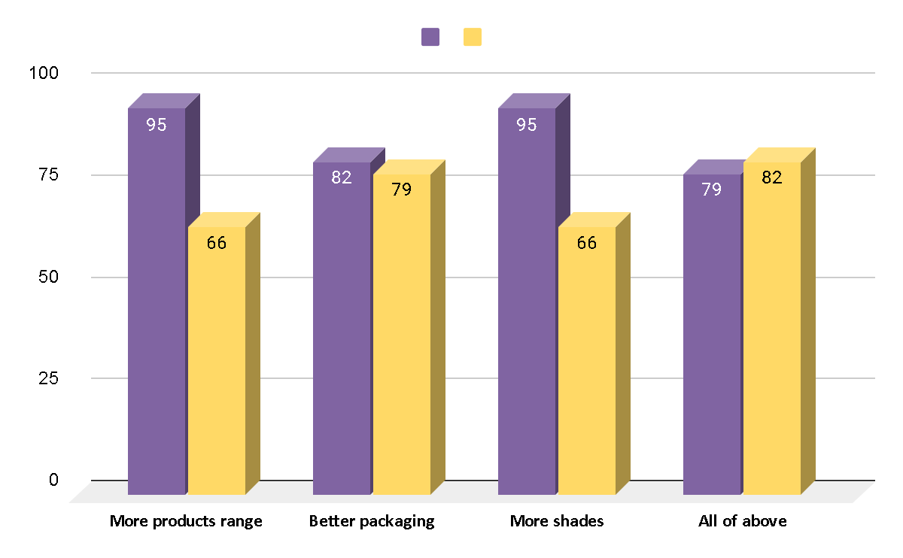
Q. 17 What changes would you like to see in both Rare beauty & Bobbi brown products?
Improvements in product range,packaging,shades offerings etc.

Slide 57
Non-Users of Rare Beauty and Bobbi Brown.

Slide 58
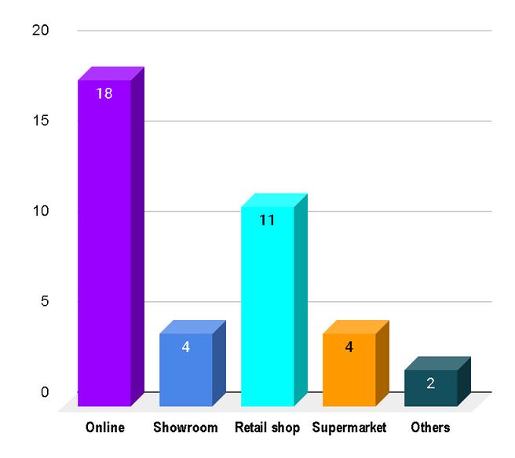
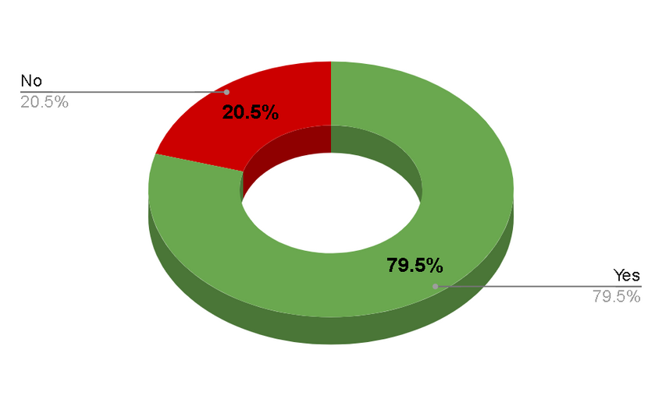
Q.1 Do you use any other Cosmetic brand?
Q.2 From where do you prefer to buy these Cosmetics?
There are 74.21% more Yes responses than No responses, with 79.5% Yes and 20.5% No.
According to the statistics, 46.15% of people prefer to purchase products online, while 28.20% of people prefer to buy them from retail shops.

Slide 59
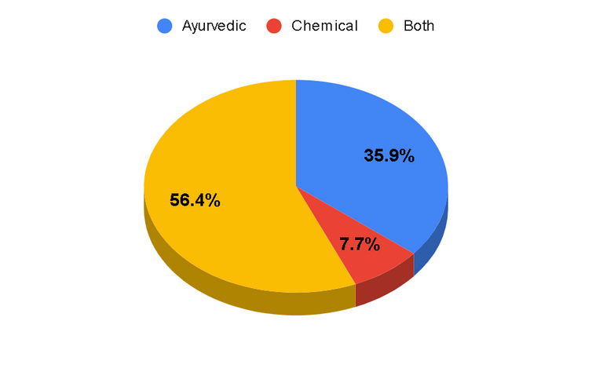
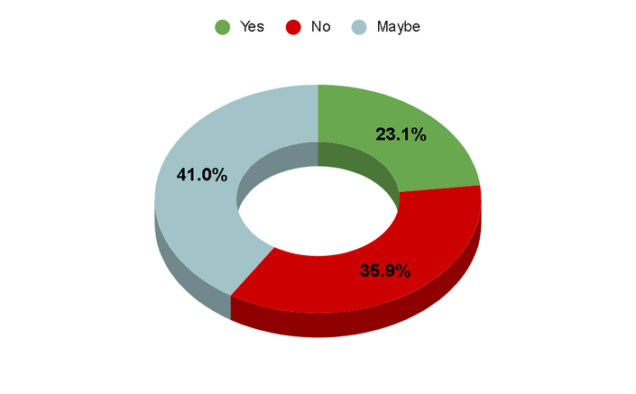
Q. 4 Do you prefer international products more than local products?
Q. 3 What type of cosmetics product you prefer to purchase?
56.4% of people choose to use both Ayurvedic
and Chemical cosmetics product
As shown in the figure,
41% of the data has been
categorised as MauBe

Slide 60
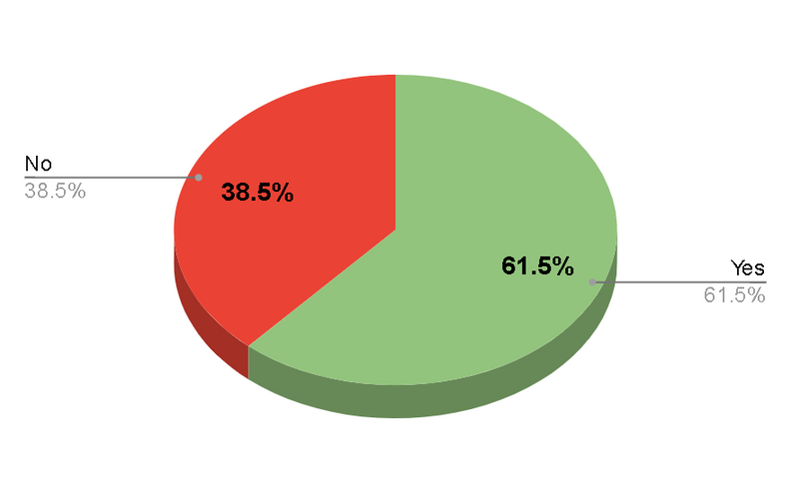
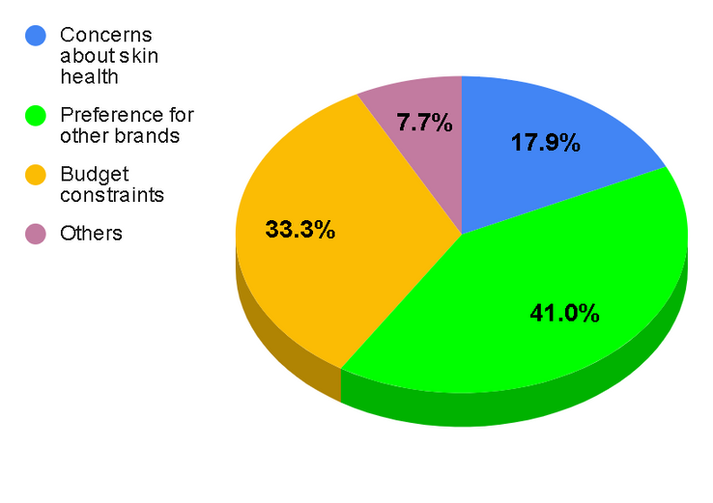
Q. 5 Would you like to continue your current brands even if there is increase in 10-15% or above in price?
Q.6 Reason for not using Bobbi Brown Cosmetics?
Only those who responded with Yes, which accounts for 61.5% of the responses, should continue with their current brand.
There were two major reasons: 41% of the data showed a preference for others, while 33.3% of the data showed budget constraints.

Slide 61
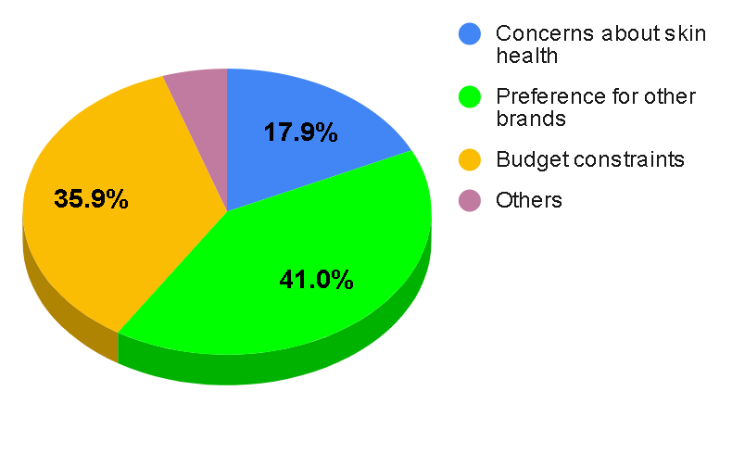
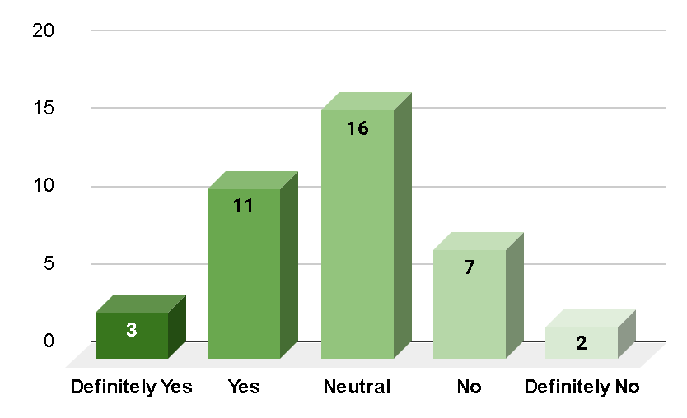
Q.7 What can be a reason for not choosing Rare Beauty Cosmetics?
Q. 8 Would you reconsider using Bobbi brown or Rare Beauty Cosmetics in the future?
There were two major reasons: 41% of the data showed a preference for others, while 35.9% of the data showed budget constraints.
Out of the total respondents,
41.02% have a neutral opinion
about reconsideration.

Slide 62
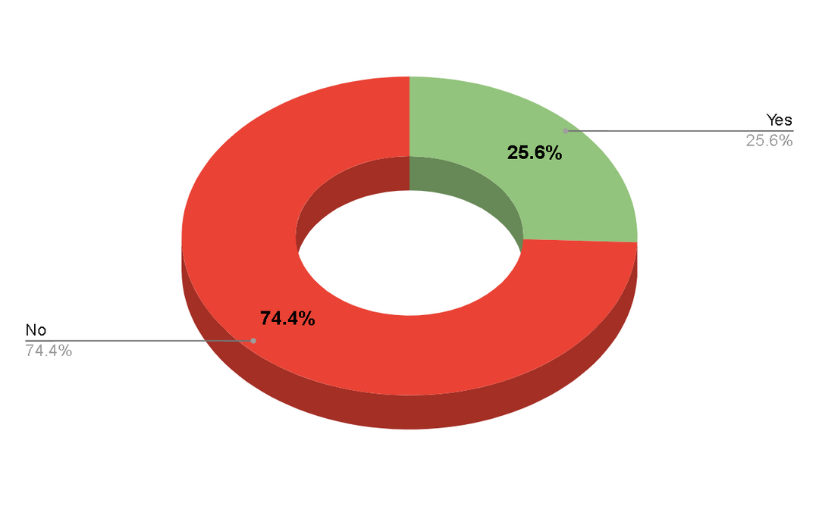
Q.9 Have you ever had any experiences, positive or negative, with Bobbie Brown or Rare Beauty Cosmetics that influenced your decisions?
According to the survey results, 74.4% of respondents have not shared their opinions or experiences.

Slide 63
Personal Data of Respondents.

Slide 64
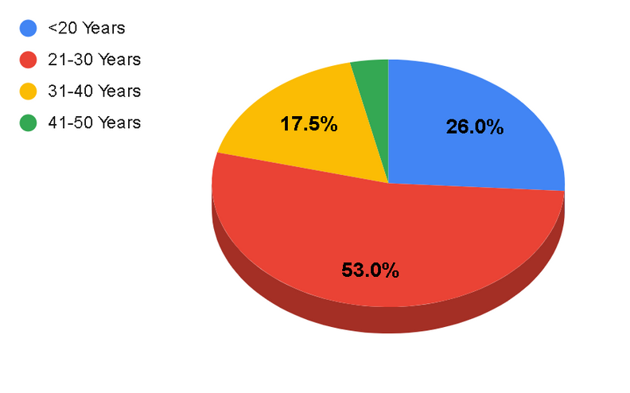
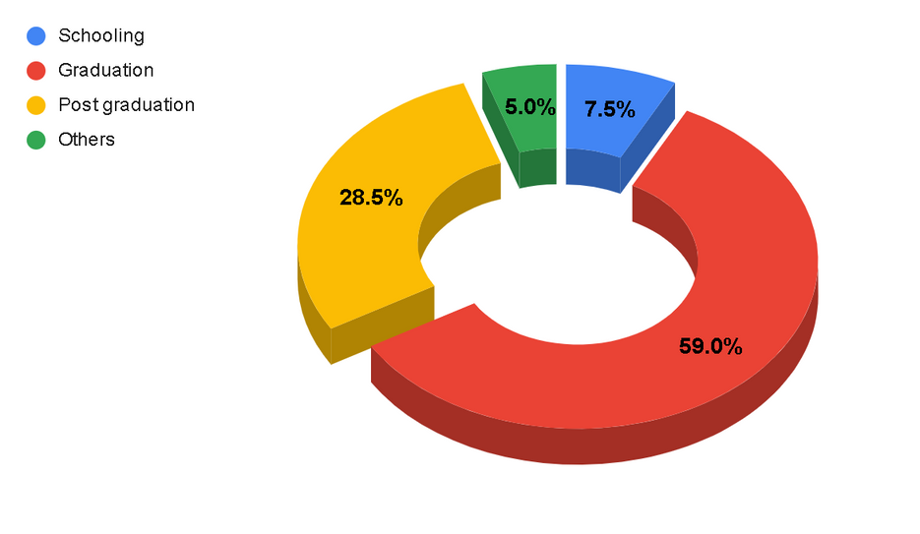
Q.1 Age?
Q. 2 Education?
The majority of the 200 respondents,
accounting for 53%, were between the ages of 21 to 30.
The majority of respondents, 59%, have
a graduation background out of 200 surveyed.

Slide 65
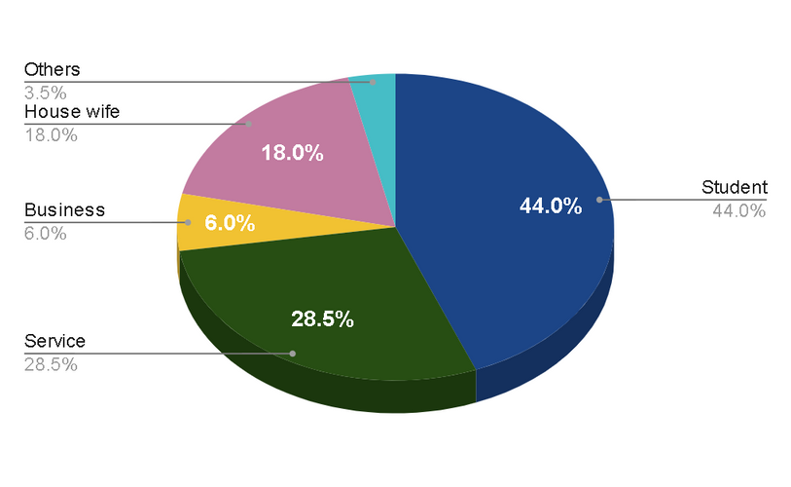
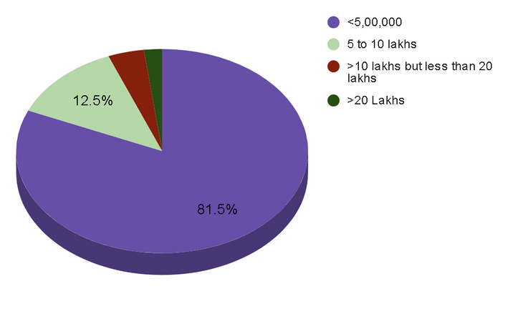
Q. 3 Occupation?
Q.4 Annual Income ( IN Rs.)?
44% of the respondents are students,
while 28.5% are working in service.
81.5% of people surveyed reported an income below 5 lakhs, while only 12.5% fell in the 5 to 10 lakh range.

Slide 66
Findings and Analysis of Primary Objectives

Slide 67
(Hypothesis – 1:- One-way ANOVA)
Null: There is no significant difference in the likelihood of purchasing products from Rare Beauty and BobbiBrown, not considering price, between the four income groups of respondents.
Alternative: There is a significant difference in the likelihod of purchasing products from Rare Beauty and Bobbi Brown, not considering the price, between the four income groups of respondents
Why One-way ANOVA is conducted?
When you have collected data about one categorical independent variable and one quantitative-dependent variable.
It is used when the interrelationship of two variables on a dependent variable
At what level of significance?
One-way ANOVA is conducted at a confidence level of 95%.

Slide 68
Descriptive = from table < 500000 to 0 std deviation value is 0.867
Tests of Homogeneity of Variances = From the table, the confidence level is 0.05. Based on the mean, the significance value is 0.094, Significance level is more than 0.05. It means the NULLvalue is accepted and the alternative is rejected as there is a relation between age and scope.
ANOVA = From the table, based on between income groups, the significance value is 0.426, A NULL value is accepted and the alternative is rejected
Multiple comparisons= from the table dependent income variable

Slide 69
(Hypothesis – 2 ;- Chi-square test of Association)
(Chi-Square test of association – consider age below 30 as one group and age above 30 as another group)
Null: There is no significant association between familiarity with beauty brands Rare Beauty and Bobbi Brown and the age of respondents.
Alternative: There is a significant association between familiarity with beauty brands Rare Beauty and Bobbi Brown and the age of respondents.
Why Chi-Square test is conducted?
The purpose of this test is to determine if a difference between observed data and expected data is due to
chance, or if it is due to a relationship between the variables you are studying.

Slide 70
At what level of significance?
A significance level of 0.05 indicates a 5% risk of concluding that an association between the variables exists when there is no actual association.
Case Processing Summary = From the table, based on considering age
Consider*age Crosstabulation
Chi-Square Tests = Therefore, at a significance level of 0.05, we can conclude that the association between variables is statistically significant.

Slide 71
Recommendations
and Conclusions

Slide 72

RECOMMENDATIONS
Dermatologist tested product.
Natural and real.
Affordable with safe Packaging.
Long lasting performance for rare beauty.
Various shades increase in lipstick from rare beauty.
Change in product in future (rare beauty).
Better foundation (rare beauty).
More shades in rare beauty.

Slide 73
CONCLUSION
Rare beauty
offering a diverse range of 48 foundation and concealer shades.
The packaging is made to be easy to use by people.
Vegan and cruelty-free beauty brand.
created by Selena Gomez with a mission to celebrate individuality.
be a safe space for mental wellbeing.

Slide 74
Bobbi brown
nailed it when it comes to formula.
Lip drying problem does not happen with these liquid lipsticks.
Balm-y texture and feel light and moisturised on the lips.
Products are free of parabens and mineral oils.
High-quality product with Vitamin Enriched
Vibrant color of long-lasting lipstick that swipes on a rich satin finish with moisturising

Slide 75
BIBLOGRAPHY
https://www.rarebeauty.com/
https://m.bobbibrown.in/
https://www.lookfantastic.com/brands/bobbi-brown.list
https://en.m.wikipedia.org/wiki/Rare_Beauty
https://en.m.wikipedia.org/wiki/Bobby_Brown
https://hbr.org/2014/10/bobbi-brown
https://www.vogue.in/topics/bobbi-brown
REFERENCE
https://www.thepeacockmagazine.com/bobbi-brown
https://www.forbes.com/sites/valentinadidonato/2021/07/11/makeup-legend-bobbi-brown-stages-her-ownbeauty-evolution/?sh=9d4af34ec5db
https://www.photobookmagazine.com/features/spring-beauty-launches-rare-beauty
https://www.vogue.in/content/exclusive-selena-gomez-brings-rare-beauty-to-india-vogue-chats-aboutinclusivity-and-self-acceptance-through-beauty
https://www.fastcompany.com/90951624/selena-gomez-rare-beauty-cosmetics-industry-juggernaut-gen-z
https://www.elle.com/beauty/makeup-skin-care/a46084426/selena-gomez-rare-beauty-find-comfort-bodycollection-interview/

